Slide 1
Face Mask Detection using machine learning
Submitted by:
Abhay Bedi (102016081)

Slide 2
Introduction to Face Mask Detection
Face mask detection has a range of applications from capturing the movement of the face to facial recognition which at first requires the face to be detected with very good precision.
Face detection is more relevant today as it is not only used on images, but also in video applications like real-time surveillance and face detection in videos.

Slide 3
Process of Face Mask Detection with Machine Learning
Step 1: Extract face data for training.
Step 2: Train the classifier to classify faces in mask or labels without a mask.
Step 3: Detect faces while testing data using SSD face detector.
Step 4: Using the trained classifier, classify the detected faces.

Slide 4
SSD FACE DETECTOR
Single Shot Multibox Detector- is a technique used to detect objects in images using a single deep neural network.
It is used for the detection of objects in an image. Using a basic architecture of the VGG-16 architecture, the SSD can outperform other object detectors such as YOLO and Faster R-CNN in terms of speed and accuracy

Slide 5
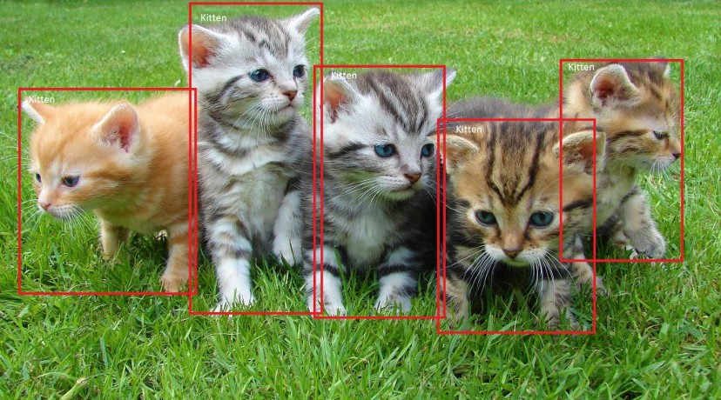
Simpler representation of how ssd works
Single Shot: this means that the tasks of object localization and classification are done in a single forward pass of the network
MultiBox: this is the name of a technique for bounding box regression
Detector: The network is an object detector that also classifies those detected objects
All classified as cats by SSD

Slide 6
Why ssd over r-cnn and yolo
By victimization SSD, we tend to solely have to be compelled to take one single shot to sight multiple objects inside the image, whereas regional proposal network (RPN) primarily based approaches like R-CNN series want 2 shots, one for generating region proposals, one for police work the article of every proposal.
SSD not only uses one grid, but a combination of different sizes to better detect objects at any size.
YOLO struggles to localize objects properly compared with quick R-CNN.YOLO has fewer background errors. quick R-CNN has 13.6% that the highest detections square measure false positive.
SSD, a single-shot detector for multiple classes that’s quicker than the previous progressive for single-shot detectors (YOLO), and considerably a lot of correct, really as correct as slower techniques that perform express region proposals and pooling (including quicker R-CNN).

Slide 7
Dataset for the project
To ensure detection capabilities of our model are as close to perfection as possible, we’ve taken a dataset of over 2340 images(2.5GB) of subjects wearing and not wearing a mask all without a face tag.
We’ve also taken into consideration that all our subjects belong to different regions/countries to ensure our trained model works well for all face types.
The whole system works well for faces that have spatial dominance. But fails in the case of images where the faces are small and take up less space in the overall image.

Slide 8
Breakdown of the project
Helper functions: 1. The getJSON function retrieves the json file containing the bounding box data in the training dataset: (border's coordinates that enclose an image)
2. The adjust_gamma function is a non-linear operation used to encode and decode luminance or tristimulus values in video or still image systems. Simply put, it is used to instil a little bit of light into the image (If gamma <1, the image will shift to the darker end of the spectrum and when gamma> 1, there will be more light in the image)

Slide 9
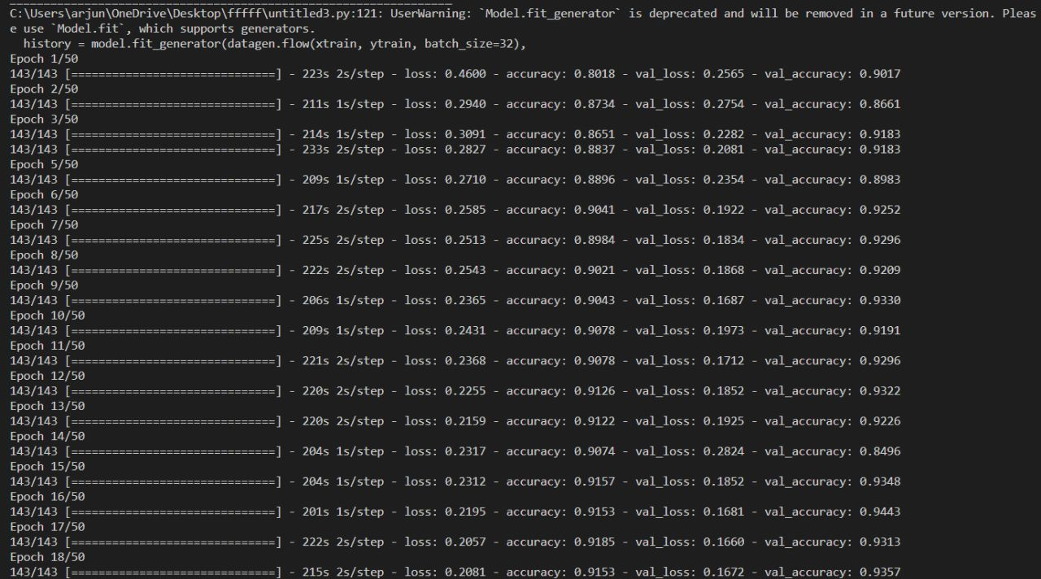
Accuracy of the trained model
After 50 epochs (iterations) of analysing and training upon the dataset, the model gave the following accuracy:

Slide 10
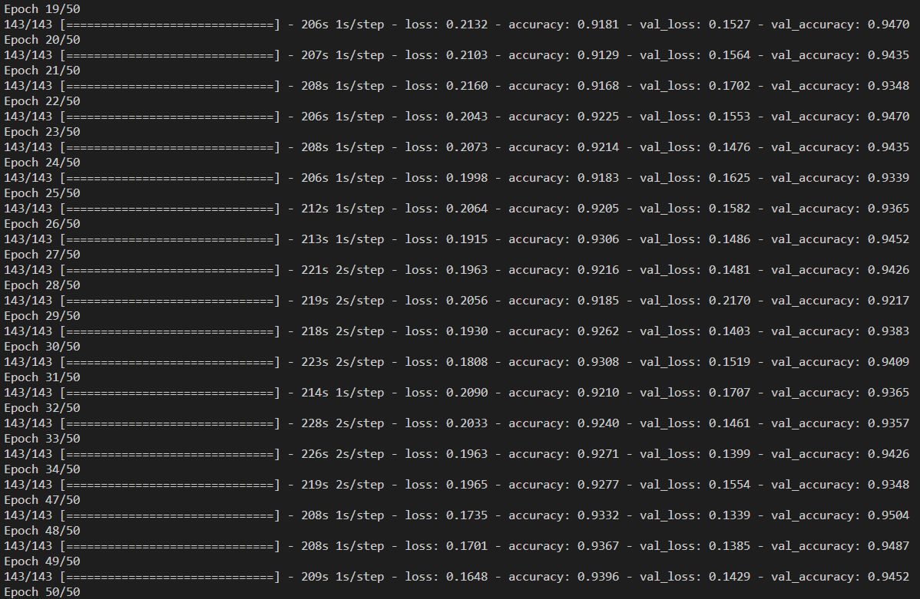

Slide 11
